Slide 1
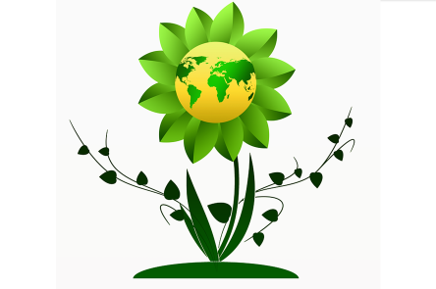
Thank you for purchasing one of my resources. I hope that you find it helpful. If you need to contact me for any reason please email me at inspireandeducate@aol.co.uk
If you are happy with this resource and would like to leave a review for it, as a token of appreciation, you can choose another of my resources for free up to the same value as your purchased resource. Just email me with your user name, the resource you have purchased and reviewed and the resource you would like for free.

Slide 2
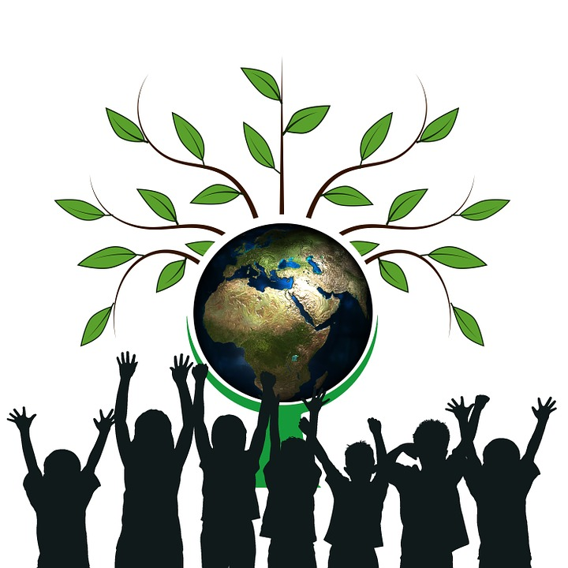
There are two Earth Days. The United Nations celebrates Earth Day each year on the March equinox. Another ‘Earth Day’ is celebrated each year on 22nd April.
Earth Day takes place very year on the 22nd of April. was founded to make people think about the planet earth and how to look after it.
Notes:
https://www.flickr.com/photos/usembassyta/6950015134/sizes/l

Slide 3
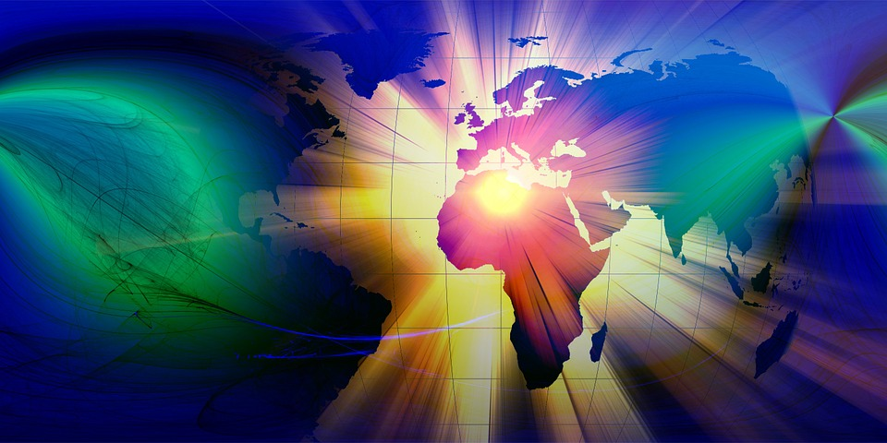
There are two Earth Days. The United Nations celebrates Earth Day each year on the March equinox. Another ‘Earth Day’ is celebrated each year on 22nd April.
Today, more than 193 countries around the world take part in Earth Day.

Slide 4
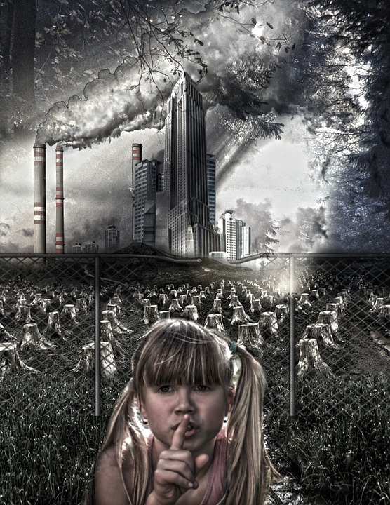
There are two Earth Days. The United Nations celebrates Earth Day each year on the March equinox. Another ‘Earth Day’ is celebrated each year on 22nd April.
Earth Day helps people to think about the things humans do that harm the earth and how we can make things better.

Slide 5
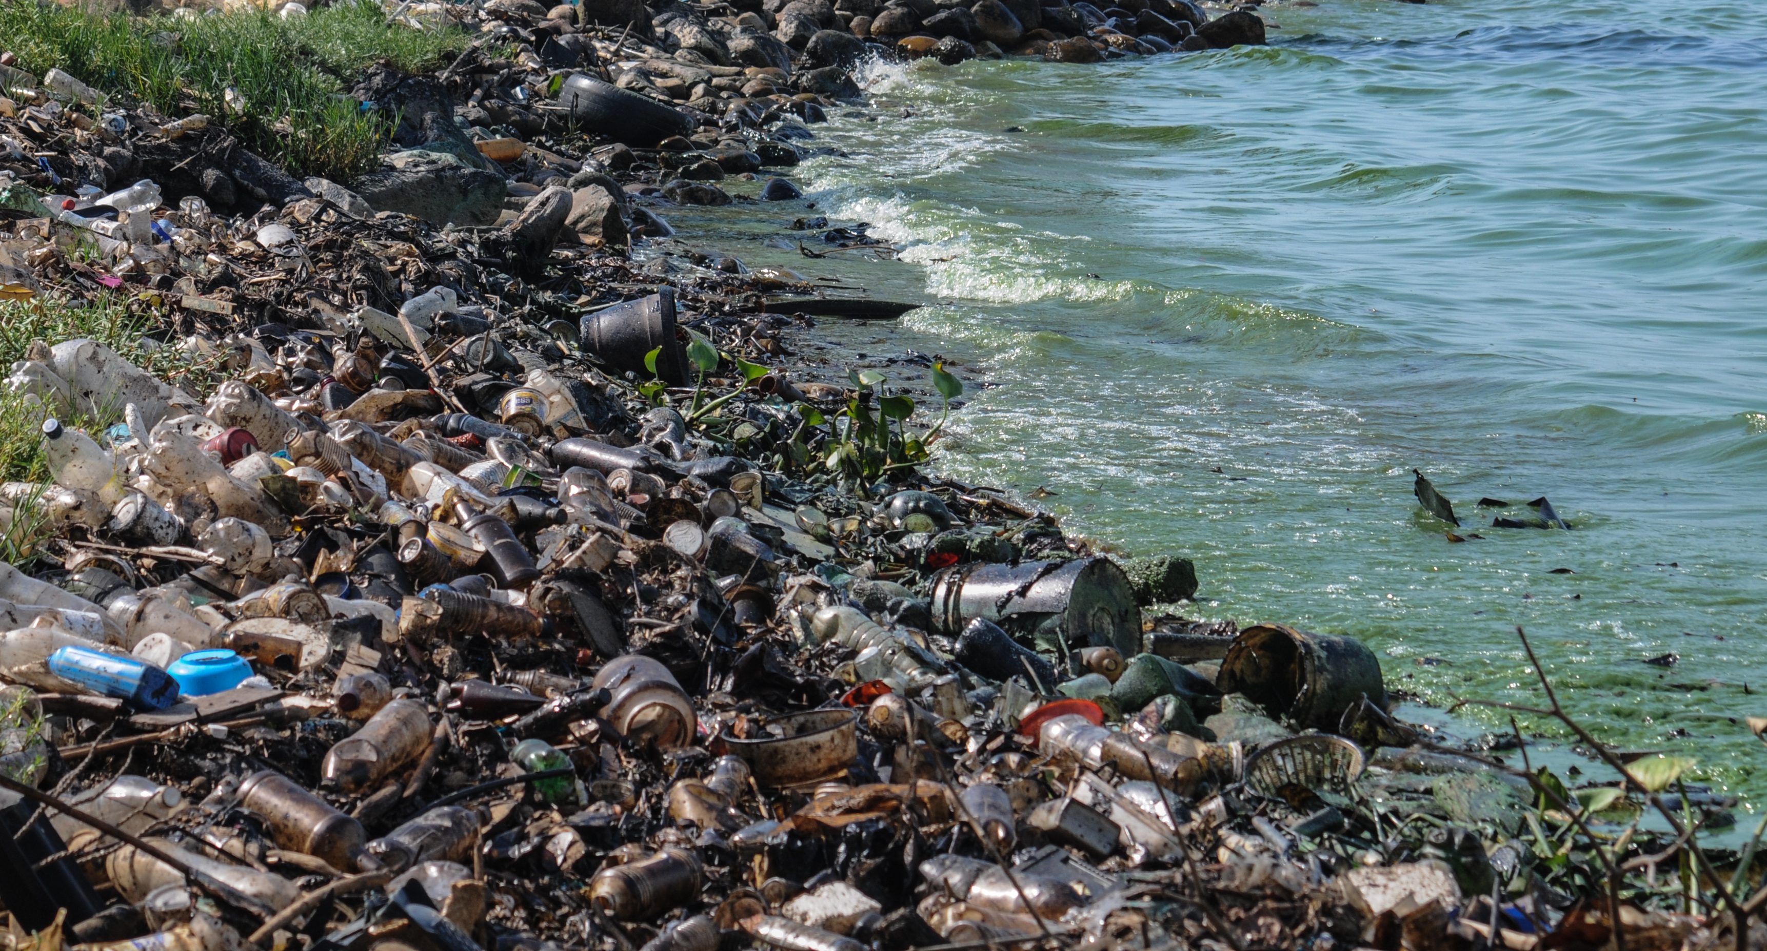
There are two Earth Days. The United Nations celebrates Earth Day each year on the March equinox. Another ‘Earth Day’ is celebrated each year on 22nd April.
Things like plastic pollution.

Slide 6
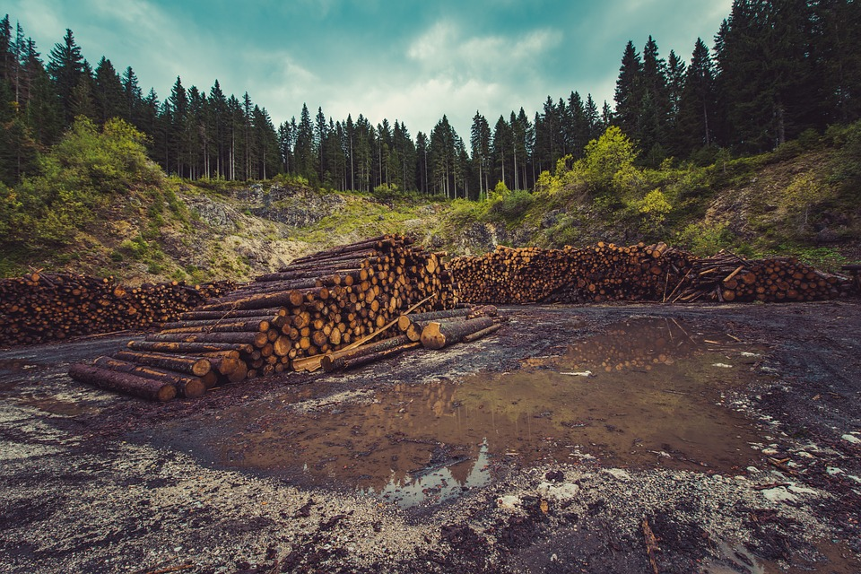
There are two Earth Days. The United Nations celebrates Earth Day each year on the March equinox. Another ‘Earth Day’ is celebrated each year on 22nd April.
Cutting down too many trees.

Slide 7
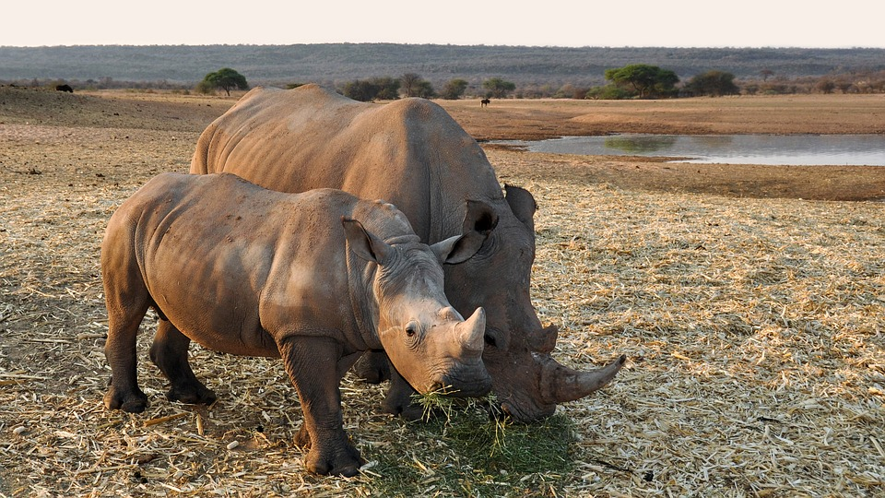
There are two Earth Days. The United Nations celebrates Earth Day each year on the March equinox. Another ‘Earth Day’ is celebrated each year on 22nd April.
When areas are harmed it affects the plants and animals that live there.

Slide 8
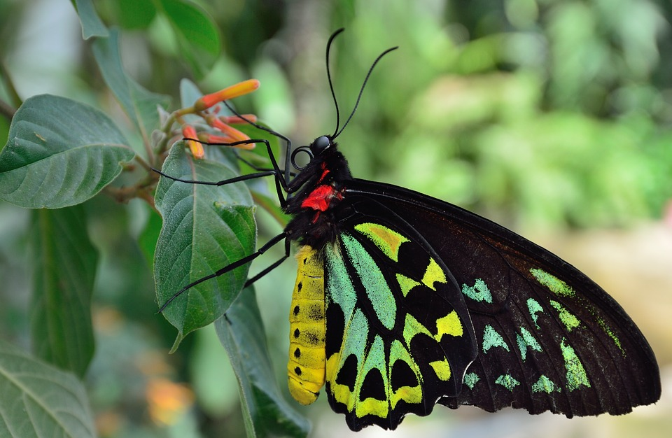
There are two Earth Days. The United Nations celebrates Earth Day each year on the March equinox. Another ‘Earth Day’ is celebrated each year on 22nd April.
It is dangerous to wildlife and can lead to animals, birds and insects becoming extinct.

Slide 9
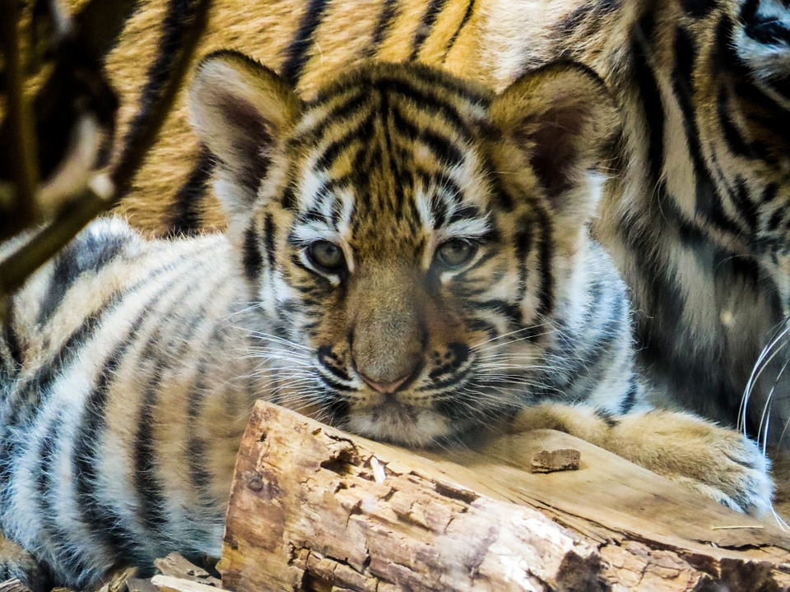
There are two Earth Days. The United Nations celebrates Earth Day each year on the March equinox. Another ‘Earth Day’ is celebrated each year on 22nd April.
Four types of tiger have become extinct due to humans harming the earth and hunting for animals.

Slide 10
There are two Earth Days. The United Nations celebrates Earth Day each year on the March equinox. Another ‘Earth Day’ is celebrated each year on 22nd April.
On Earth Day people do things to make the earth better. Here a garden is being planted in Israel.
Notes:
https://www.flickr.com/photos/usembassyta/7096087317/sizes/l

Slide 11
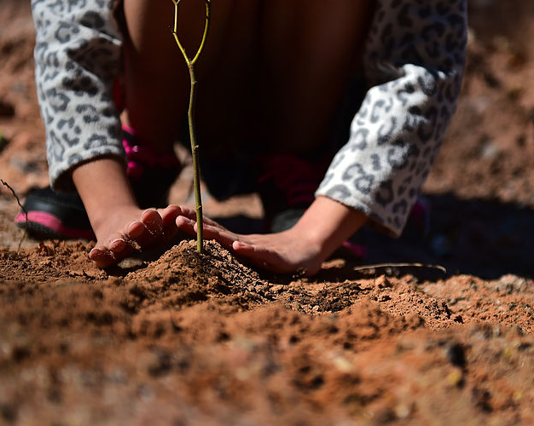
There are two Earth Days. The United Nations celebrates Earth Day each year on the March equinox. Another ‘Earth Day’ is celebrated each year on 22nd April.
2020 marked the 50th anniversary of Earth Day. To mark 50 years, Earth Day Network set a goal of planting 7.8 billion trees - one tree for every person on earth.
Notes:
https://commons.wikimedia.org/wiki/File:RES_students_plant_trees_for_Earth_Day_150422-F-NH180-003.jpg

Slide 12
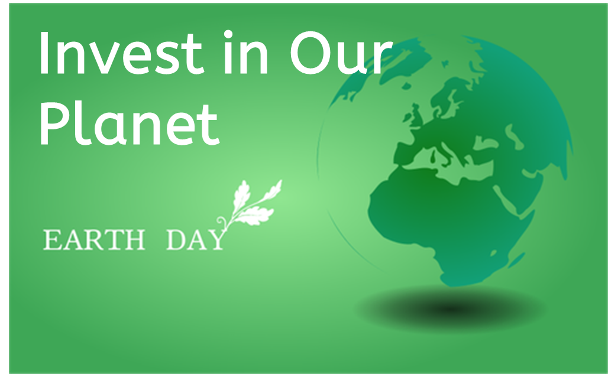
Each year Earth Day has a theme. In 2022 and 2023 the Earth Day theme was ‘Invest in Our Planet’. It encouraged governments, businesses and people to develop and use green solutions to help to combat climate change.
Notes:
https://www.flickr.com/photos/unarmedcivilian/8636951093

Slide 13
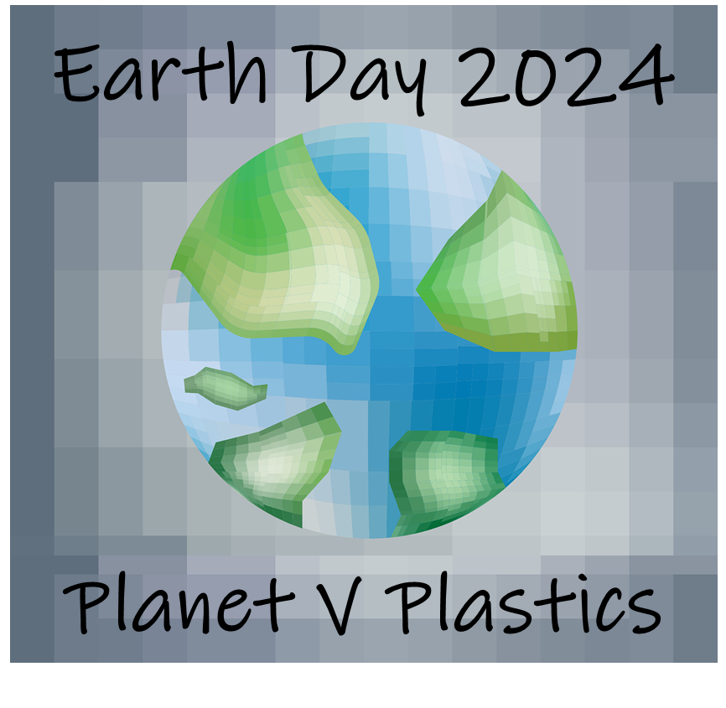
The Earth Day theme for 2024 is “Planet v Plastics”. It is encouraging countries, governments, organisations and individuals to take action to reduce plastic production by 60% by 2040.
Notes:
https://www.flickr.com/photos/unarmedcivilian/8636951093

Slide 14
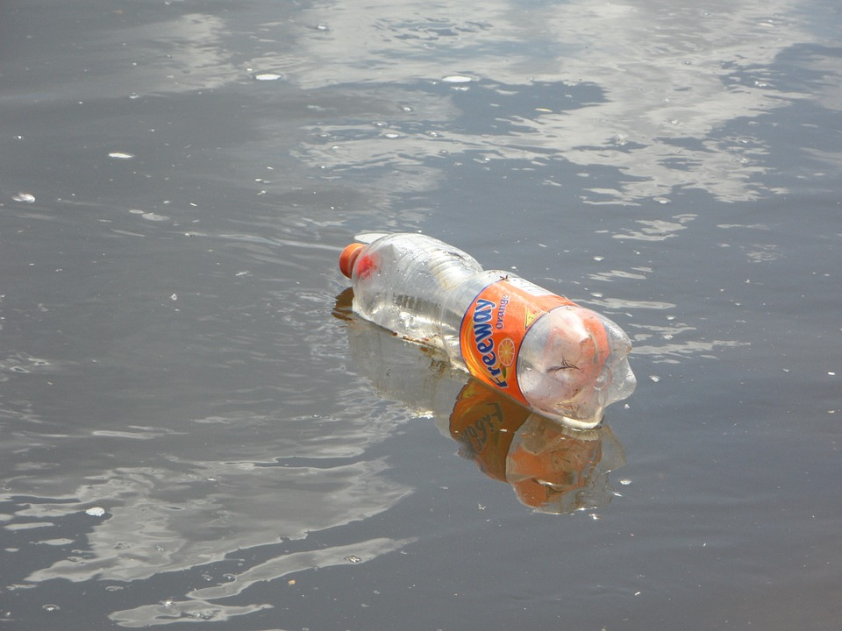
Plastic objects that we use once and throw away are a growing world-wide problem.
Notes:
https://www.flickr.com/photos/jurvetson/134466058/sizes/l

Slide 15
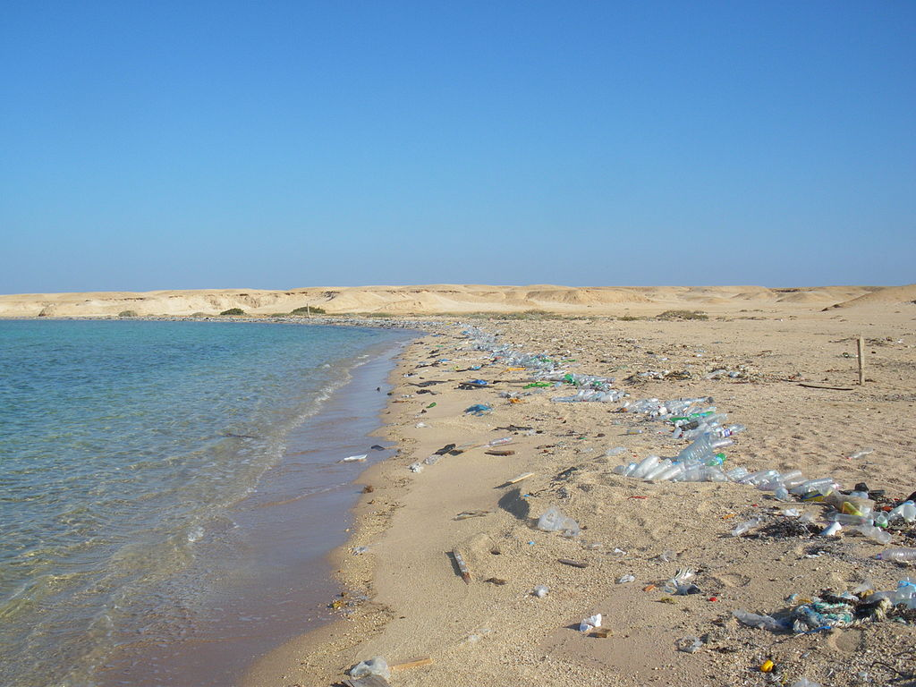
Every square mile of the sea has more than 46,000 pieces of plastic in it.

Slide 16
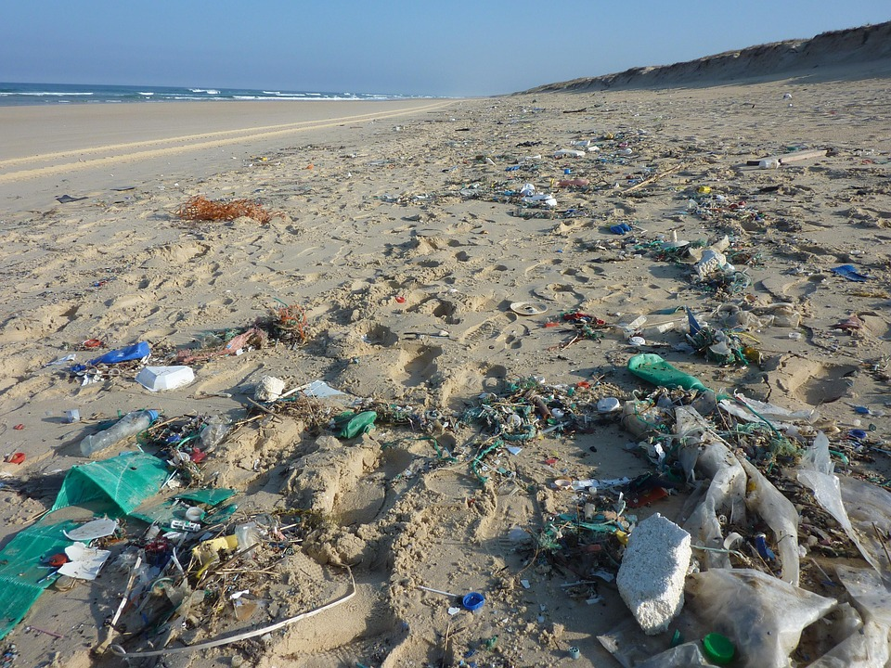
About 8 million tons of plastic goes into the oceans each year.

Slide 17
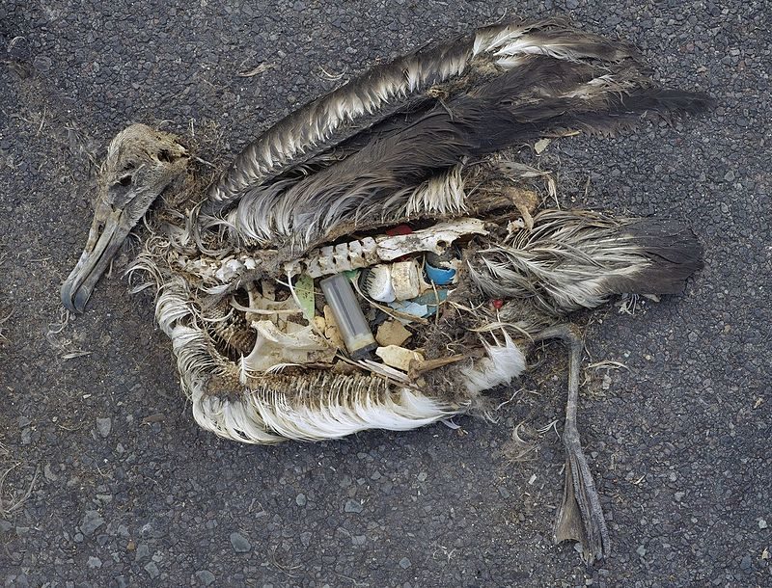
The chemicals used in some plastics are harmful to human health and have been linked with cancer. Plastics also harm animals, birds, and sea creatures.
Notes:
Von Chris Jordan (via U.S. Fish and Wildlife Service Headquarters) / CC BY 2.0 - Albatross at Midway Atoll RefugePhoto taken by Chris JordanUploaded by Foerster, Gemeinfrei, https://commons.wikimedia.org/w/index.php?curid=26762401

Slide 18
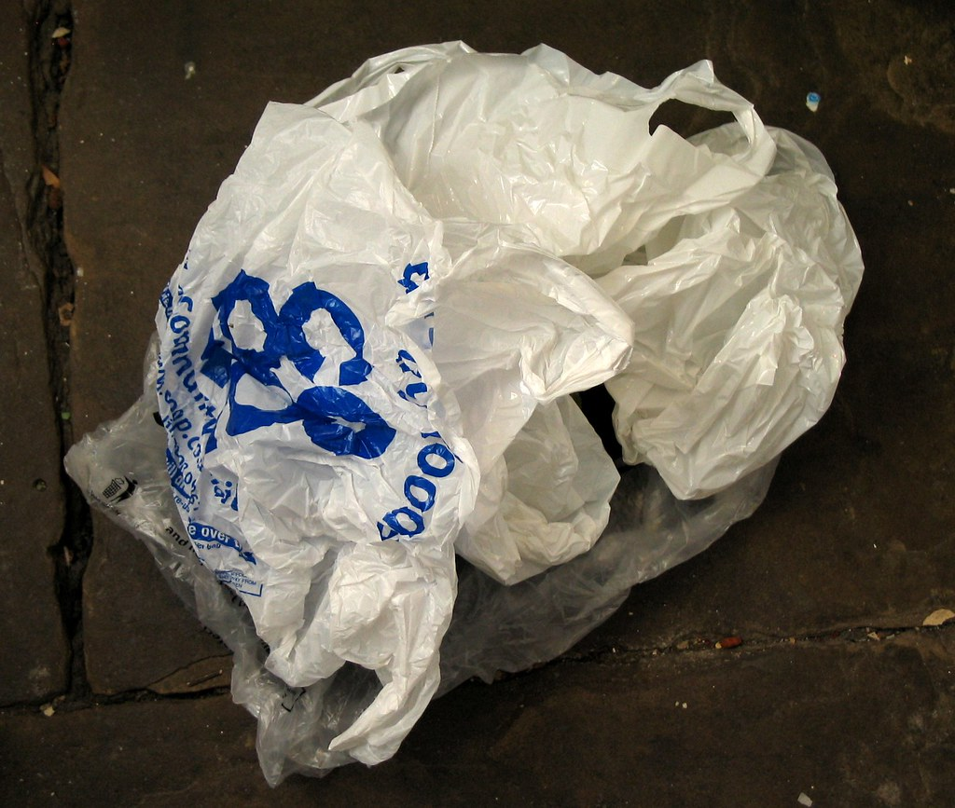
More than 500 billion plastic bags were produced worldwide in 2023. That is equal to one million bags per minute. Most plastic bags are used for a very short time yet take hundreds of years to break down.
Notes:
https://www.flickr.com/photos/recyclethis/167934944

Slide 19
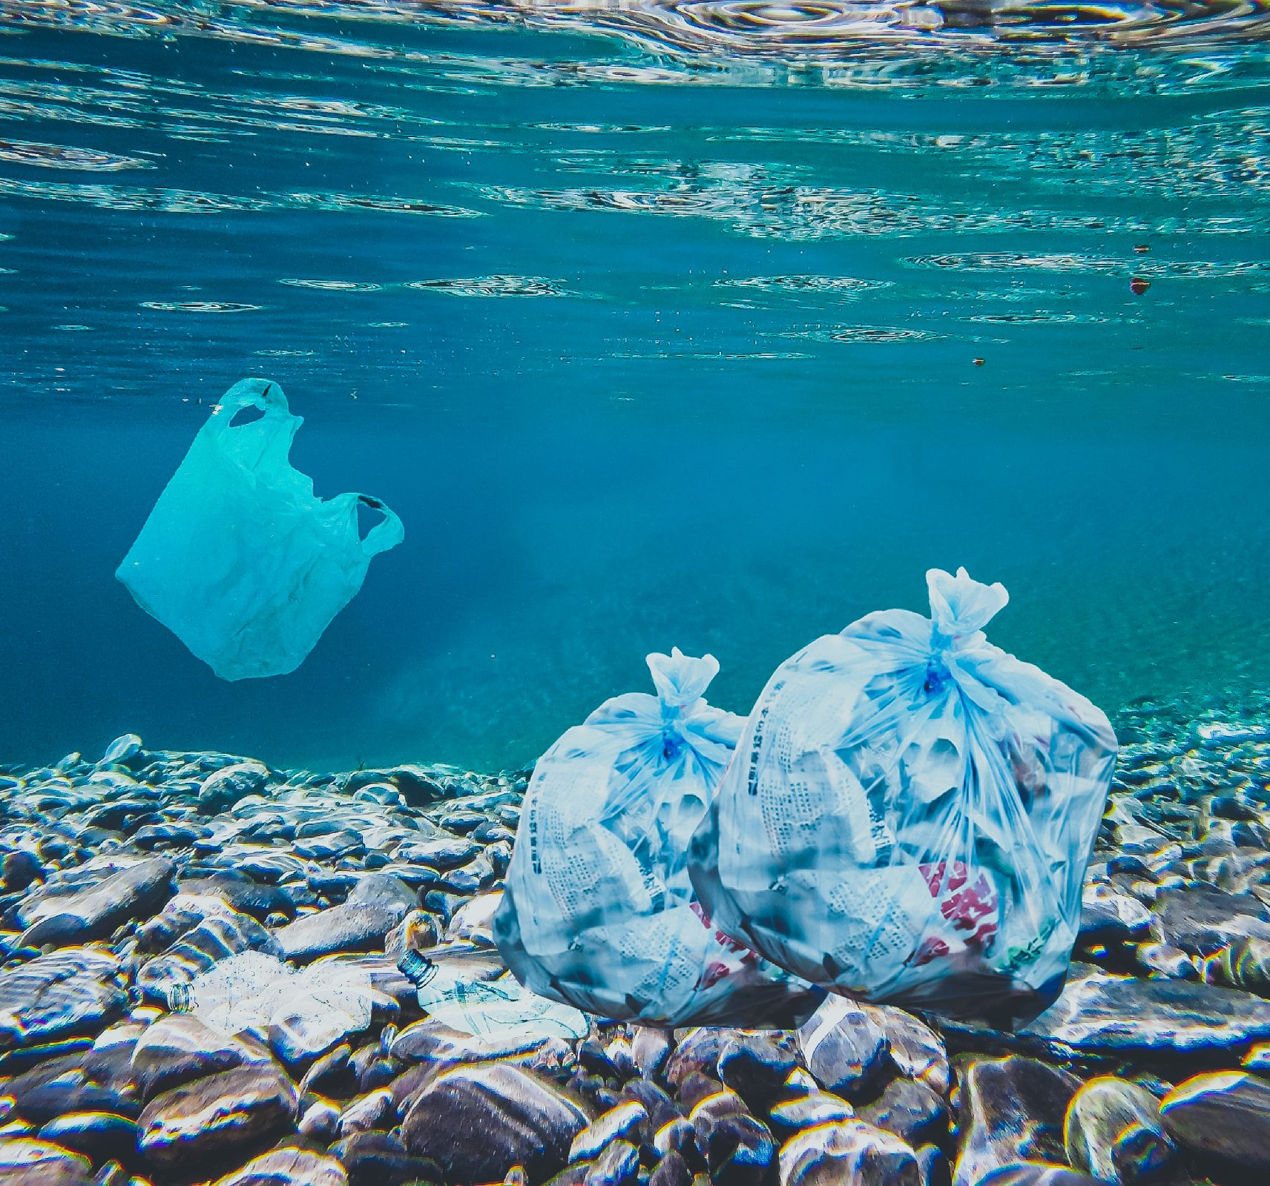
At least 11 million tons of plastic are dumped into our oceans every year. That is equal to dumping one refuse truck full of plastic into the ocean every minute. If nothing is done, this will increase to two trucks a minute by 2030 and four per minute by 2050.
Notes:
https://www.flickr.com/photos/unarmedcivilian/8636951093

Slide 20
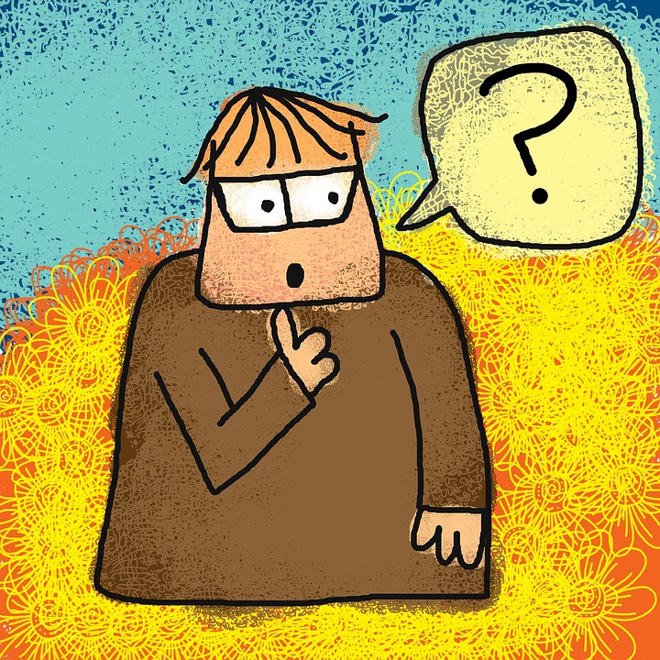
So, what can we do to reduce plastic production?
Notes:
https://www.flickr.com/photos/planeta/7188495344/sizes/l

Slide 21
We could ask the local shops, cafes and restaurants we visit to stop using plastic packaging. We could refuse plastic cutlery, straws and cups and tell them why.

Slide 22
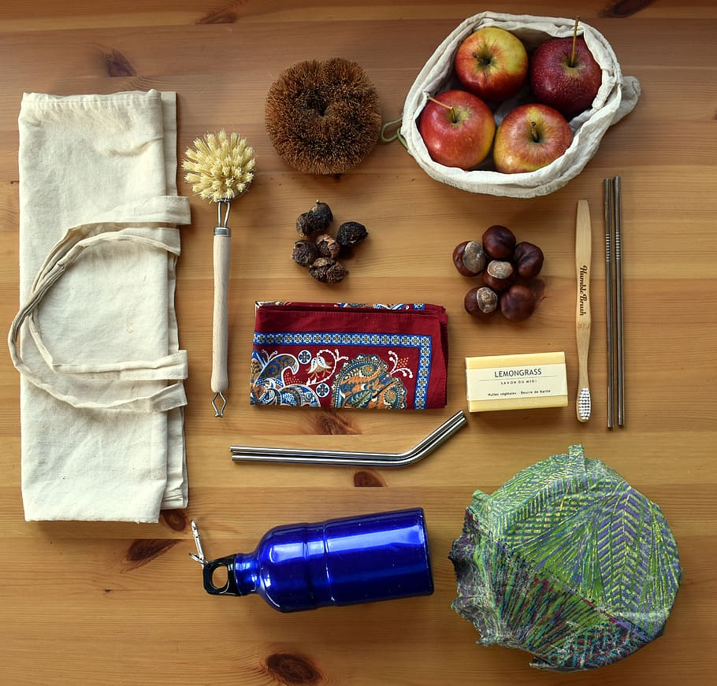
When shopping we could choose food with no plastic packaging and buy plastic free products.
Notes:
https://www.pxfuel.com/en/free-photo-xtkxb

Slide 23
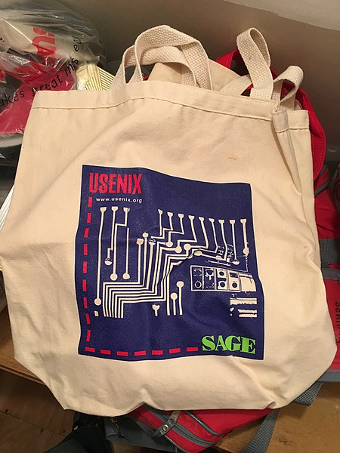
We could use a reusable bag for our shopping.
Notes:
https://commons.wikimedia.org/wiki/File:Behttps://commons.wikimedia.org/wiki/File:USENIX_tote_bag.jpgach_plastic_waste_9.jpg

Slide 24
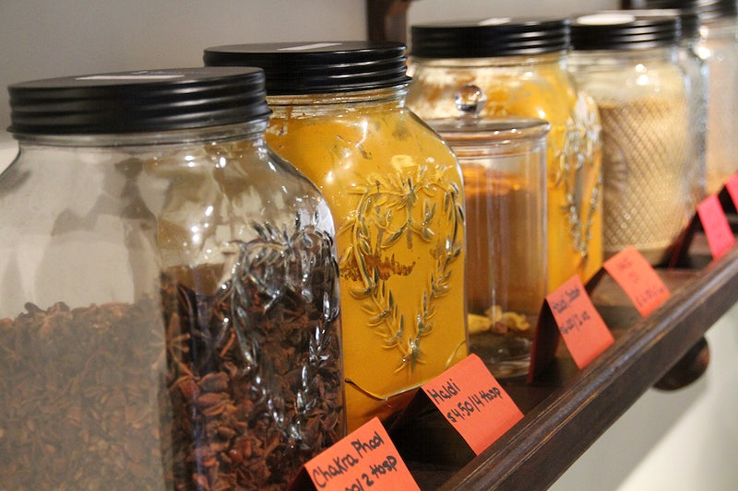
We could buy loose products and take a re-usable container to put them in.
Notes:
https://commons.wikimedia.org/wiki/File:Beach_plastic_waste_9.jpg

Slide 25
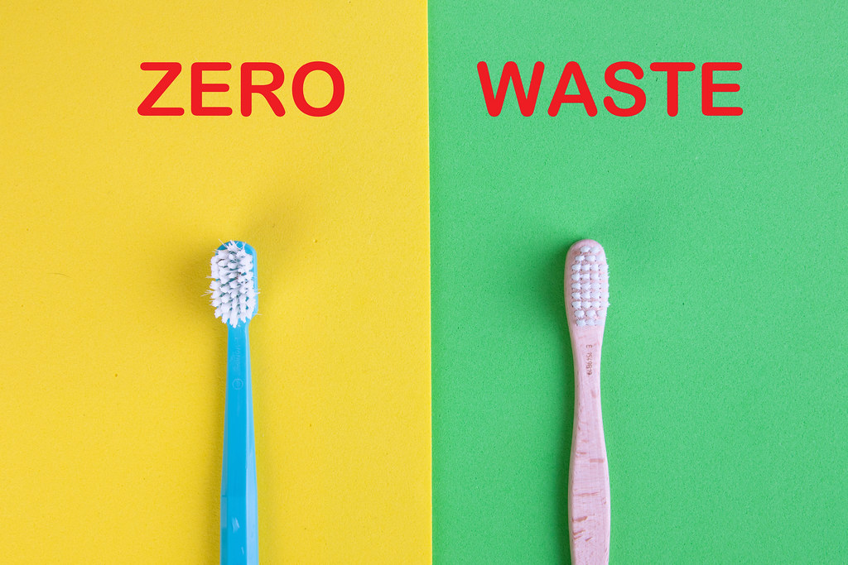
We could try to change to a zero-waste lifestyle. We could use bamboo toothbrushes instead of plastic toothbrushes.
Notes:
https://www.flickr.com/photos/30478819@N08/48551776982

Slide 26
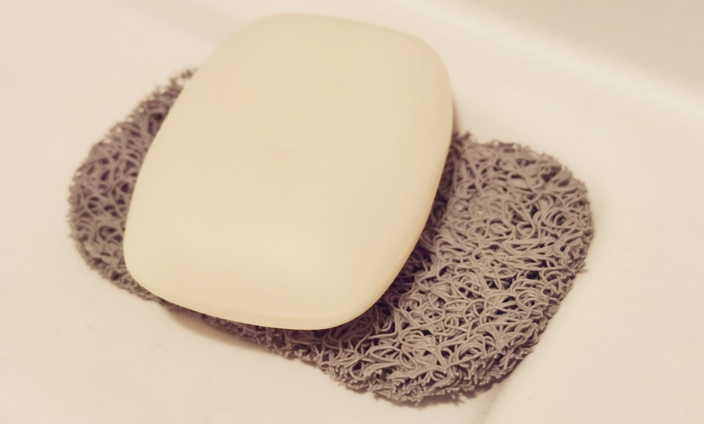
We could choose plastic-free personal care products such as soap and shampoo bars.
Notes:
https://pixabay.com/sv/photos/tv%c3%a5l-plast-gratis-rakning-underh%c3%a5ll-6261658/

Slide 27
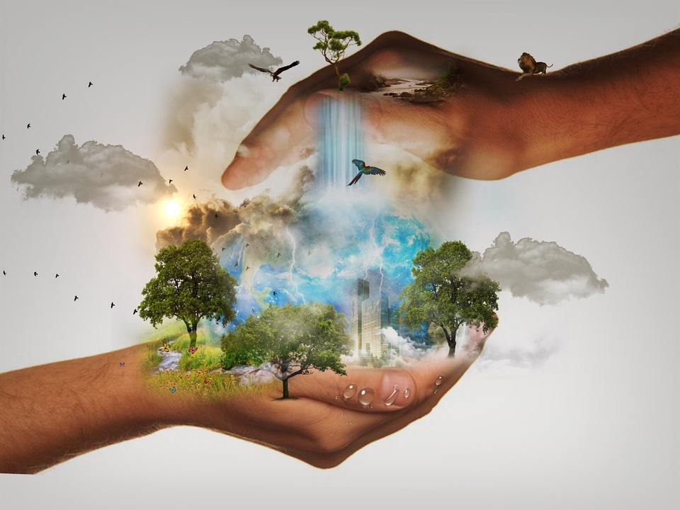
We can use Earth Day as a time to think about our own impact on the environment.

Slide 28
There are two Earth Days. The United Nations celebrates Earth Day each year on the March equinox. Another ‘Earth Day’ is celebrated each year on 22nd April.
We can do many things to help improve our environment. We can help by recycling.

Slide 29
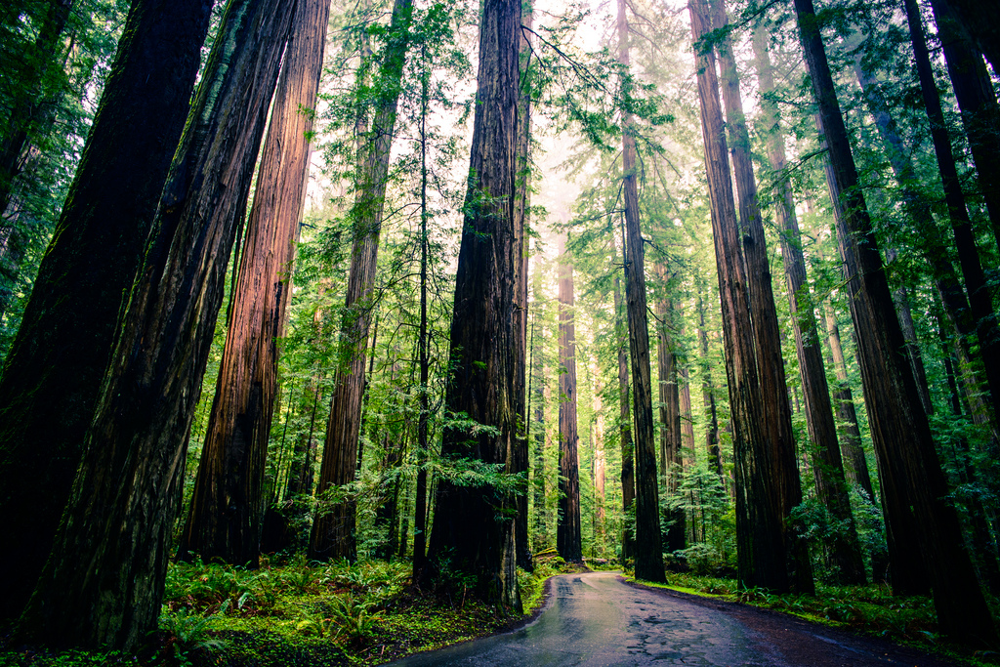
Recycling one ton of paper saves between 15 and 17 mature trees.
There are two Earth Days. The United Nations celebrates Earth Day each year on the March equinox. Another ‘Earth Day’ is celebrated each year on 22nd April.
Notes:
https://www.flickr.com/photos/michaelbalint/8634008094/sizes/l

Slide 30
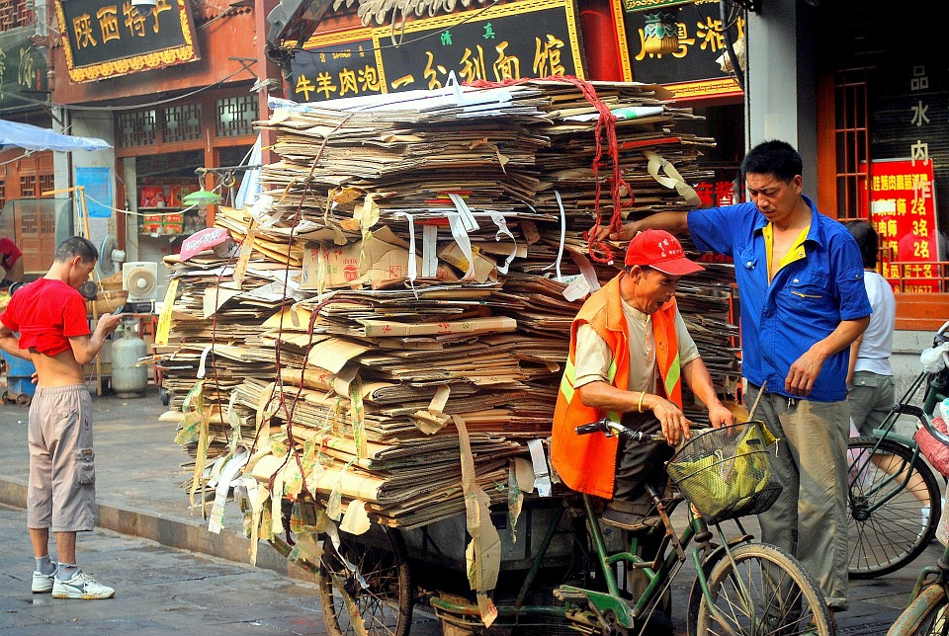
There are two Earth Days. The United Nations celebrates Earth Day each year on the March equinox. Another ‘Earth Day’ is celebrated each year on 22nd April.
Recycling one ton of paper can save enough energy to heat a home for six months.

Slide 31
There are two Earth Days. The United Nations celebrates Earth Day each year on the March equinox. Another ‘Earth Day’ is celebrated each year on 22nd April.
We can help by putting rubbish in a bin.

Slide 32
There are two Earth Days. The United Nations celebrates Earth Day each year on the March equinox. Another ‘Earth Day’ is celebrated each year on 22nd April.
We can help by reducing our usage of energy. We can switch off lights when we leave a room.

Slide 33
There are two Earth Days. The United Nations celebrates Earth Day each year on the March equinox. Another ‘Earth Day’ is celebrated each year on 22nd April.
We can turn off computers and TVs when we are not using them.

Slide 34
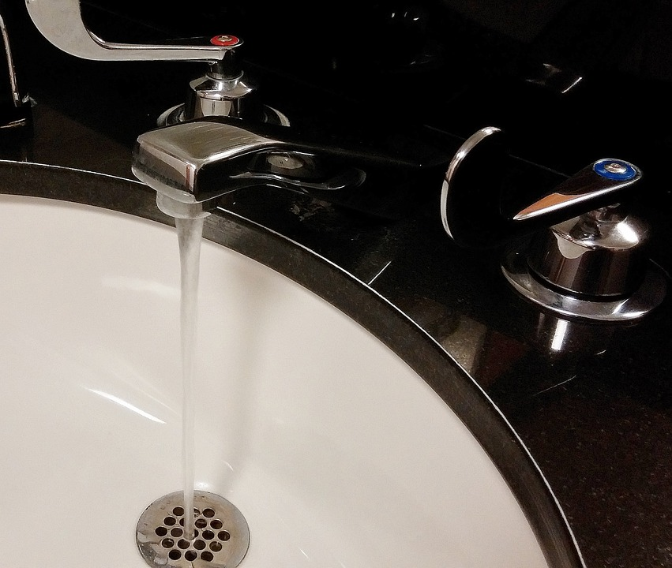
There are two Earth Days. The United Nations celebrates Earth Day each year on the March equinox. Another ‘Earth Day’ is celebrated each year on 22nd April.
We can switch off the tap when brushing our teeth.

Slide 35
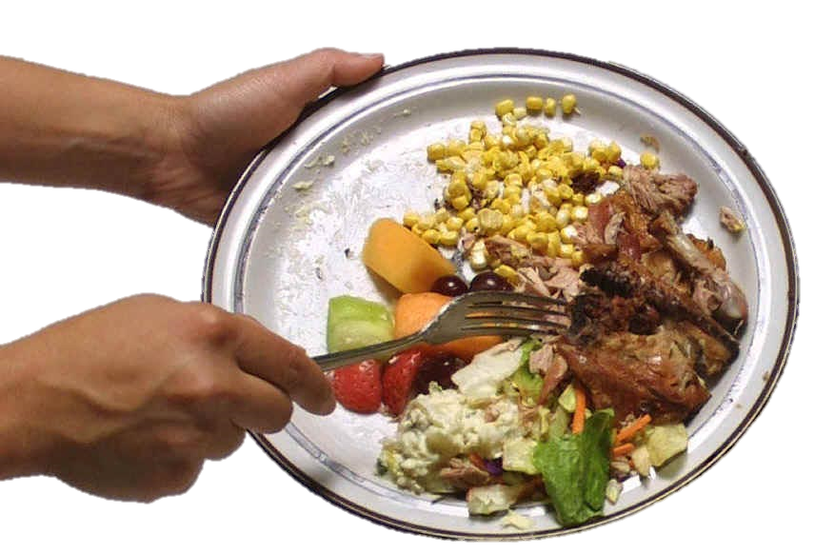
There are two Earth Days. The United Nations celebrates Earth Day each year on the March equinox. Another ‘Earth Day’ is celebrated each year on 22nd April.
We can cut down on food waste.
Notes:
https://www.flickr.com/photos/32123311@N00/502155430/sizes/o/

Slide 36
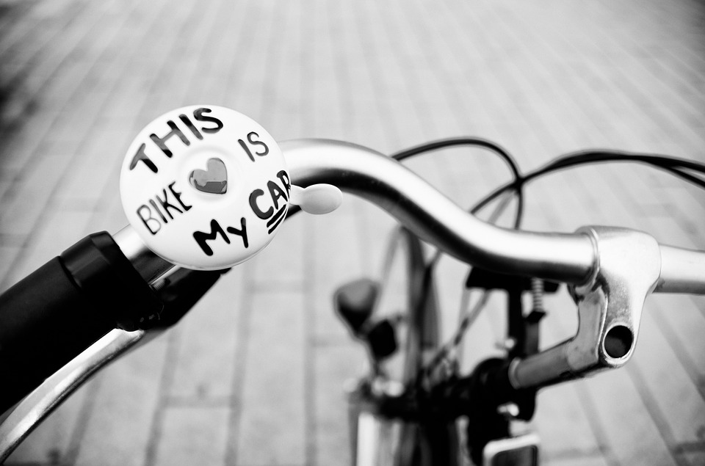
There are two Earth Days. The United Nations celebrates Earth Day each year on the March equinox. Another ‘Earth Day’ is celebrated each year on 22nd April.
We can walk or cycle to places instead of travelling by car.

Slide 37
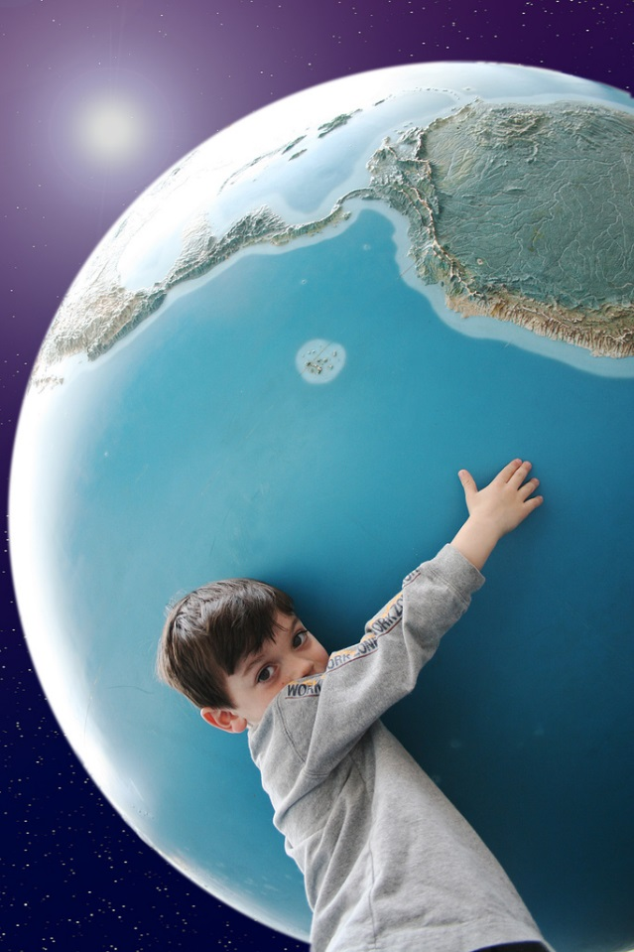
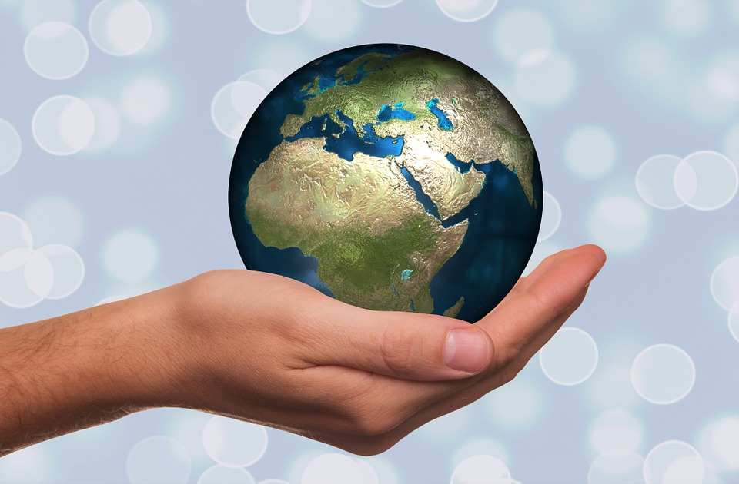
There are two Earth Days. The United Nations celebrates Earth Day each year on the March equinox. Another ‘Earth Day’ is celebrated each year on 22nd April.
We can make every day an Earth Day.
Notes:
Boy https://www.flickr.com/photos/wwworks/440672445/sizes/l

