Slide 1
Year 1 Phonics workshop

Slide 2
What is phonics?
Phonics is the system of sounds we use to work out what words say and how to spell them
It’s the same as ‘sounding out’. In school we call it ‘Fred talk'
44 sounds (lots of ways to make these sounds)
Notes:
Phonics is the system of sounds we use to work out what words say and how to spell them
Give example – c-a-t b-a-th
You may have heard of ‘sounding out’ to help children decipher words
Unfortunately there are more sounds than letters in the alphabet and in the English language there are 44 sounds to learn so it’s not surprising some children find it difficult at first!

Slide 3
Reading
There are several parts to reading:
Book behaviours
Enjoyment
Comprehension (understanding)
Decoding – we use phonics for this part

Slide 4
Almost all weaker readers have difficulty in blending sounds from letters to make words. Almost all good readers do this well.
We cannot read fluently until we read accurately, and this depends on accurate use of the information conveyed by letters.
Skilled, fluent readers do not guess.

Slide 5
Why Read Write Inc ?
Read Write Inc. Phonics is a complete literacy programme, for 3 to 7 year-olds learning to read and write. Although reading is taught using synthetic phonics, the programme is so much more than that. It covers all of the new National Curriculum requirements for language and literacy.
https://www.ruthmiskin.com/en/find-out- more/parents/

Slide 6
How do we teach RWInc?
We teach a systematic approach:
Sounds in order
How to blend these sounds together to read words
How to read RWInc books with these sounds in

Slide 7
How do we teach the sounds?
the hook (the memorable picture)
My turn, your turn – the sound
how to write the sound (the handwriting phrase)
We recap sounds taught so far until there are several known quickly
We teach blending for reading and writing words

Slide 8
Blending
When we initially learn to read we say each sound in a word and then blend or squash the sounds together to read the word.
In most preschools children will have been shown how to aurally blend the sounds in words. In FS2 children learn and consolidate this

Slide 9
Fred talk
This is the RWInc term for segmenting the sounds in words.
Fred the frog uses ‘Fred talk’ , the children are asked to aurally blend the sounds to make meaning from the ‘Fred talk’.
Once the children are able to independently ‘Fred talk’ they can work out how to spell a word.
Fred talking is separating the sounds in the words, not the letters.

Slide 10
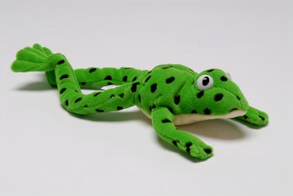
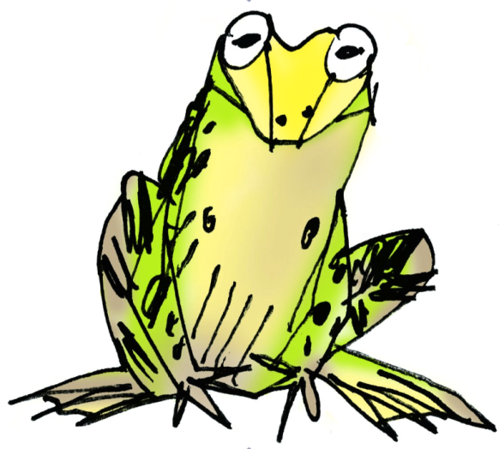
Fred talk
cat c – a – t
Notes:
After we’ve learnt the memory phrase and the letters which make that sound we learn to Fred talk words with that sound in. This is Fred. In RWInc he helps children to focus and learn to blend. He can only talk in ‘Fred talk’ or sound out. So he can only say c-a-t not cat. But we are teaching him. When we orally blend I tell the children the word in Fred has told me and they squash those sounds together and blend them into a word. For example…

Slide 11
Green word cards
Fred talk
Notes:
Then we are ready to read words. This is a green word card and the children learn that when its on green and has the sound buttons underneath they know they need to Fred talk it. Either because it has new sounds or we need to show off our Fred talk. Example of pressing sound buttons and reading word with longer Set 2 example.

Slide 12
Fred fingers
Writing
Notes:
We learn to write words by using Fred fingers. When we do Fred fingers we think about how many sounds are in a word, put that many sounds on one hand, palms facing the person reading and a pointing finger on the other. Then we press those sounds onto our fingers, like this. Then we Fred talk as we write the word.

Slide 13
After secure with set 1
sounds we learn…
Set 2 and set 3 sounds
Digraphs = special friends = 2 letters,1 sound
Trigraphs = special friends = 3 letters,1 sound
Notes:
Together these make the simple speed sounds chart. This has at least one way to spell most sounds and can be used to remind us of the sounds, used for writing and checking we know them.

Slide 14
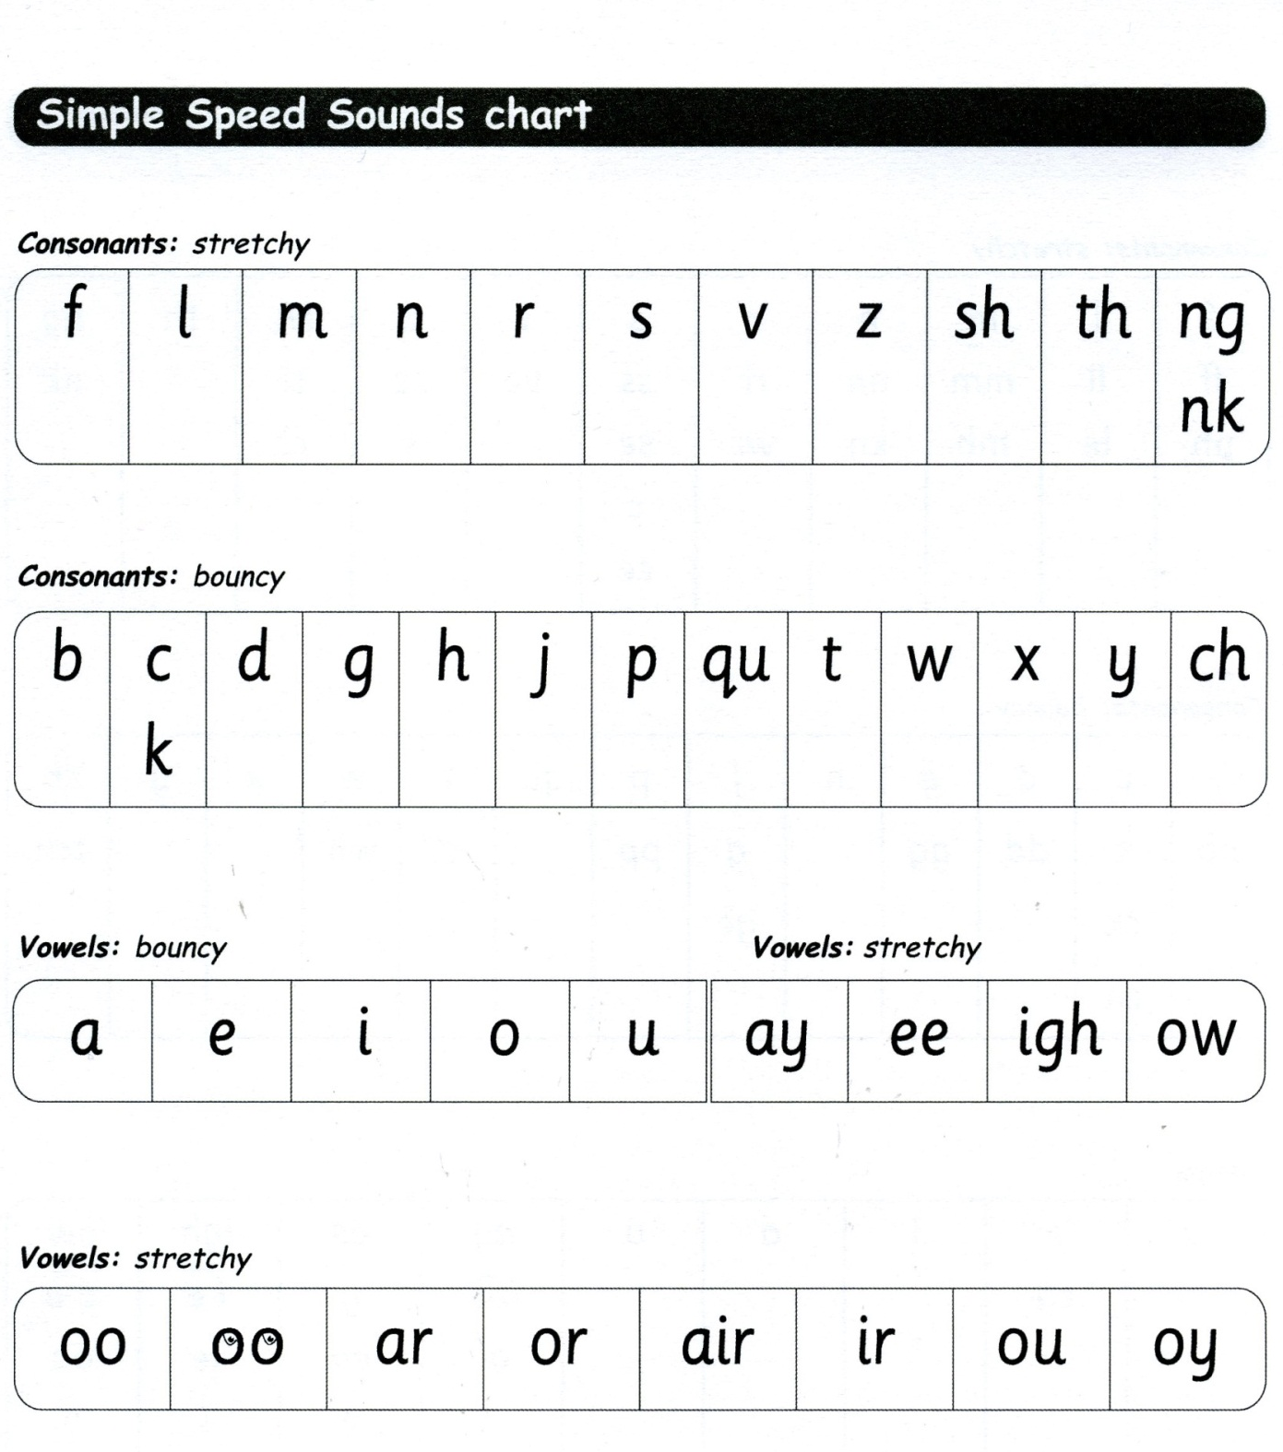
Set 2 sounds
Notes:
Most children in Year 1 should now be secure with these sounds and using in their writing

Slide 15
Set 3 sounds
ea oi a-e i-e o-e u-e aw ur
er ow ai oa ew ire ear ure
Notes:
Set 3 sounds - magic ‘e’ and split digraphs, alternative grapheme. E.h ow/ow
Some children are learning these sounds now at this point in year 1 and applying to writing

Slide 16
Alternative graphemes
ay - pay
ai - snail
a-e - snake
ey - grey
eigh - eight

Slide 17
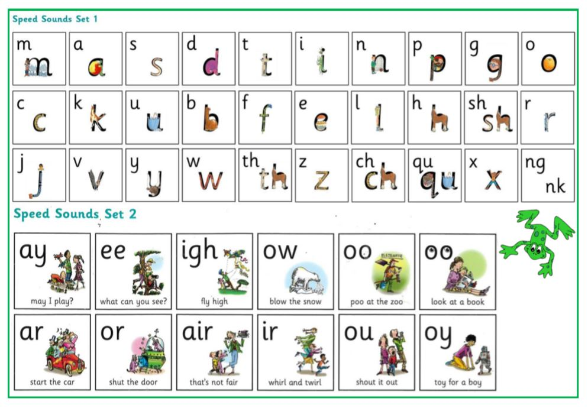
Sound cards

Slide 18
Common exception words
Red Words
Can’t be sounded out (you can’t Fred a red)
Need to be recognised and spelt
Introduced in RWI and class phonics and spellings (weekly homework task)
the

Slide 19
Common exception words

Slide 20
Reading at home
RWI book (changed each Thursday) Bug club online (to be used to
access 2nd reading book each week)

Slide 21
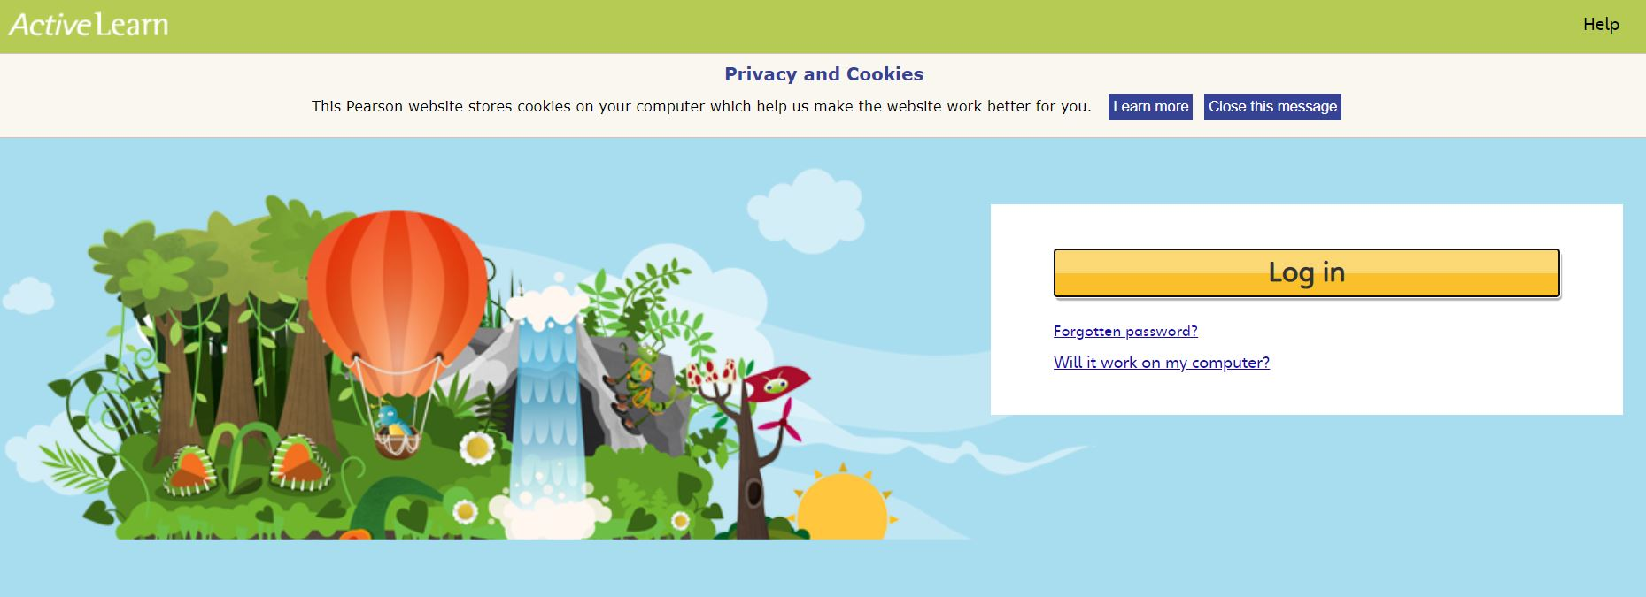
Bug Club

Slide 22
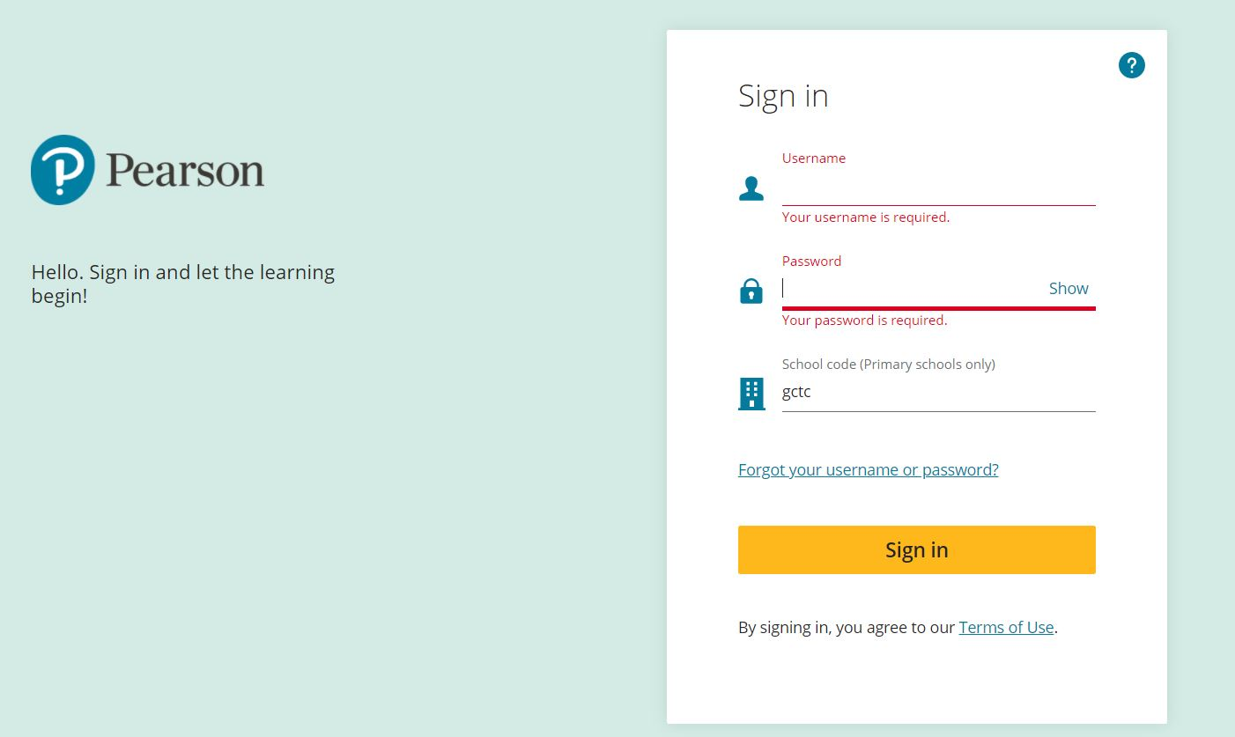
Bug Club

Slide 23
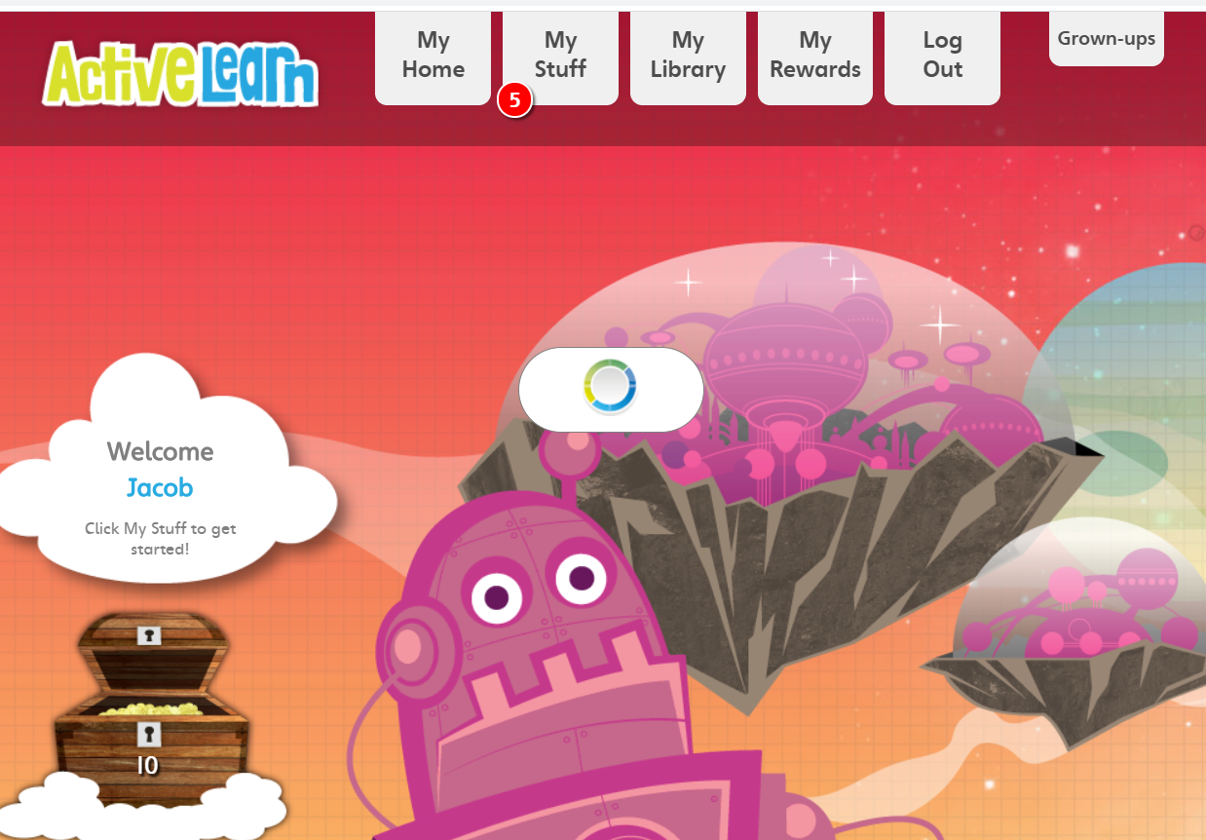
Bug Club

Slide 24
Bug Club Logins remain the same as those issued in FS2 Read one book each week 2-3 times to develop fluency and comprehension If you run out please email us

Slide 25
Reading comprehension
Year 2’s big focus
Book activities refer to text
Understanding
Inference
Reasoning

Slide 26
Helping your child at home
IT IS SOOOOOOO VALUABLE
All reading counts!
Books – fiction and non-fiction, leaflets, comics, magazines, newspapers, signs, maps, recipes, instructions, e-books, web pages, cereal boxes, other packaging, red word cards, green word cards, school book banded books, RWInc home readers, shopping list, poetry, jokes, bible, prayers ....
.

Slide 27
Helping your child at home
Little and often
Learning to read is a key skill needed to access the world around them and in particular learning.
However very important that they enjoy it – try and foster a lifelong love of reading.

Slide 28
Reading for pleasure
This sometimes means reading to them – letting them access stories with more interest and a higher vocabulary than they can read.
Allow children to choose
Ask open questions
Allow them to make links and defer from the story
Get it ‘wrong’ – ☺ - they’ll soon tell you!

Slide 29
Online fun reading activities:
http://www.phonicsplay.co.uk/Phase4Menu.htm
http://www.bbc.co.uk/cbeebies/shows/alphablocks
https://phonicsplaycomics.co.uk/comics.html

Slide 30
Year 1 phonic screening

Slide 31
Why Year 1?
All pupils in Y1 will complete the check
The check will take place the week commencing 7th June 2021
It will be administered by a teacher on a 1:1 basis
You will be told if your child has met the expected standard with the end of year report.
Their score will be reported to the LA, then government

Slide 32
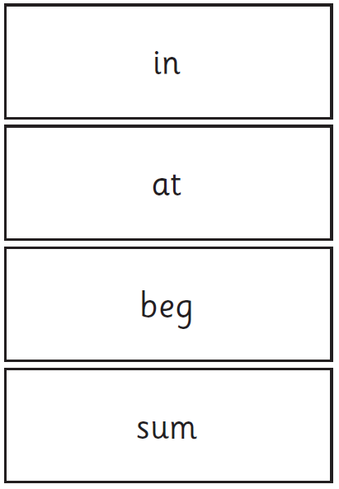
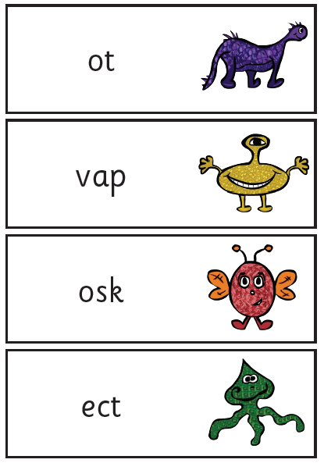
Examples
2012
Notes:
Show 2012 test too.

Slide 33
Class Phonics and spellings/reading
Term 1 - Common exception words sent home to read
From Term 2 - we will begin uploading spellings
(to the class page) linked to the 2 new set 2 or
set 3 sounds each week
Everyone exposed to sounds regardless of RWI level
Games

Slide 34
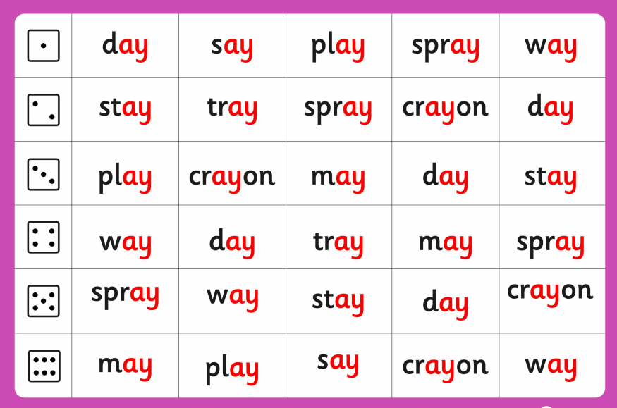

Slide 35
Questions
Please email us if you have any queries

